Slide 1
INFO6003 Lab-10
Gihan Shamike Liyanage
1142109

Slide 2
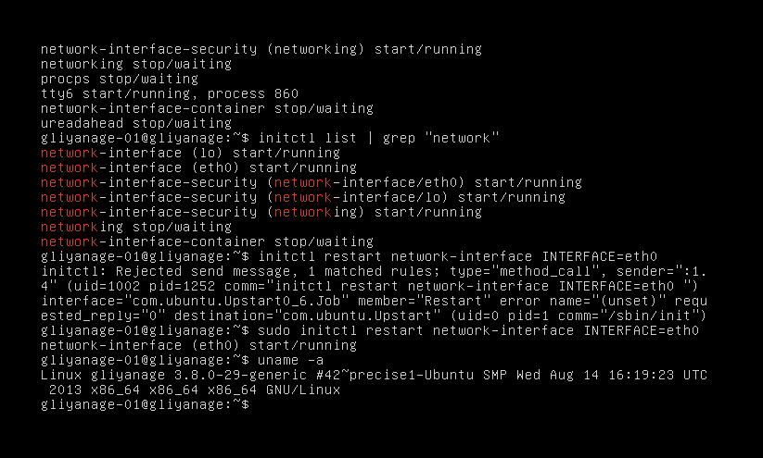
Slide #1
“initctl restart network-interface INTERFACE=eth0” This command will fail, why did it fail?
The initctl command requires root privileges to run, so you will need to use sudo to run it with elevated privileges.

Slide 3
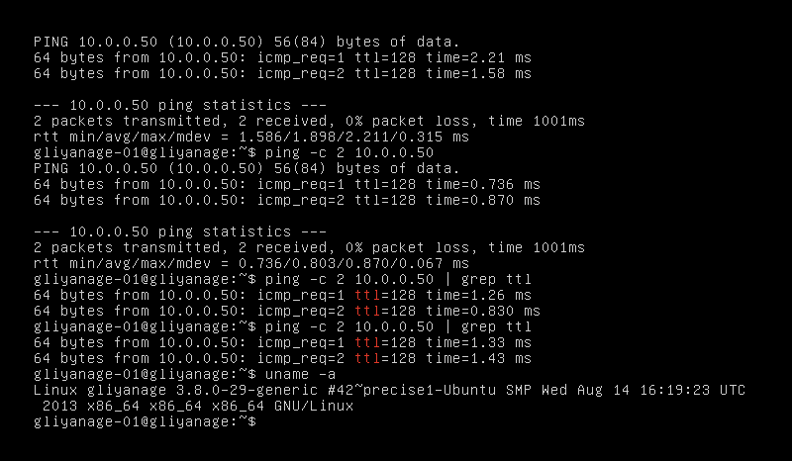
Slide #2

Slide 4
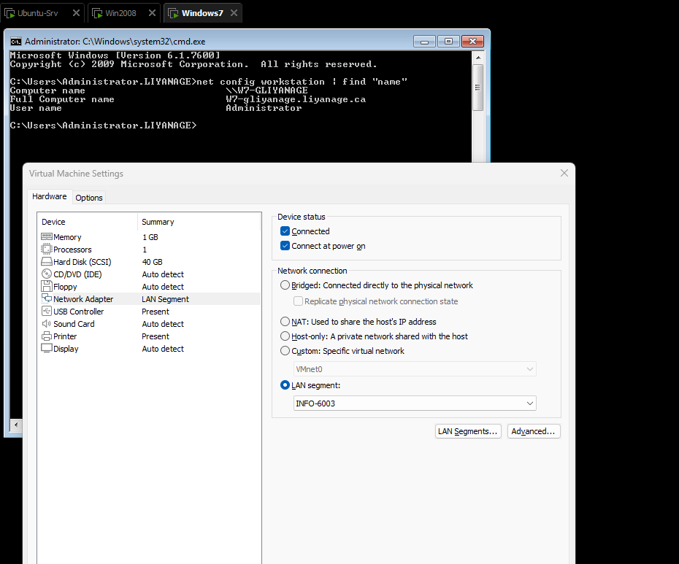
Slide #3

Slide 5
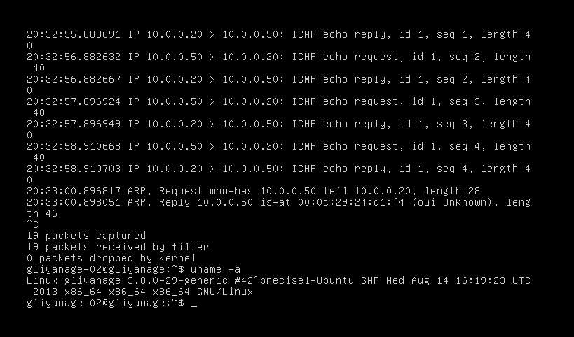
Slide #4

Slide 6
tcpdump -n What does the -n do?
The -n option in the tcpdump command is used to disable the name resolution of IP addresses and ports. When this option is used, tcpdump will display the IP addresses and ports as numeric values rather than resolving them to their corresponding hostnames or service names.
This command should fail because FOLusername-02 doesn’t have the appropriate permissions.
What does the error tell you?
The sudo command allows users to execute commands with elevated privileges, but it requires that the user is authorized to do so in the system's configuration. By default, not all users are authorized to use sudo.

